Slide 1
CSci 3081W: Program Design and Development
Lecture 14 – Development Processes

Slide 2
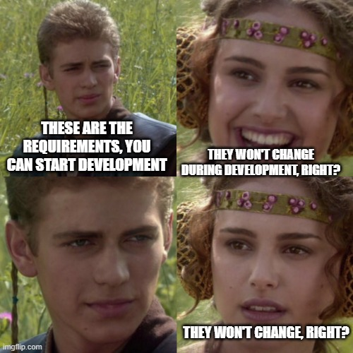
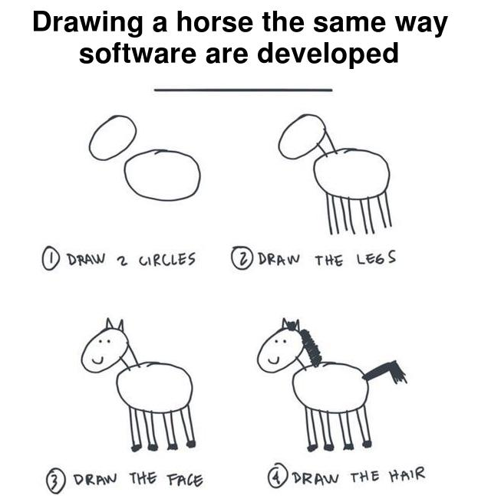
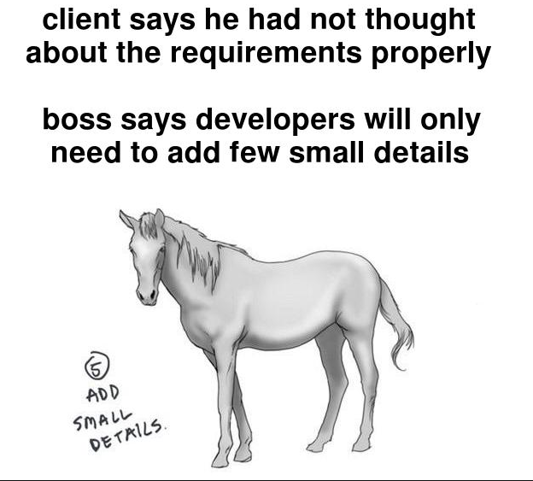
Challenges with Waterfall

Slide 3
Challenges with Waterfall
During verification – pieces don’t work together which leads to an expensive fix
Users/clients argue that the system doesn’t meet the initial requirements (Predicting user needs is very difficult)
Potential market shift which also leads to an expensive fix

Slide 4
Agile
17 people, Feb 2001
Agile Manifesto
Agile is a mindset
4 values and 12 principles

Slide 5
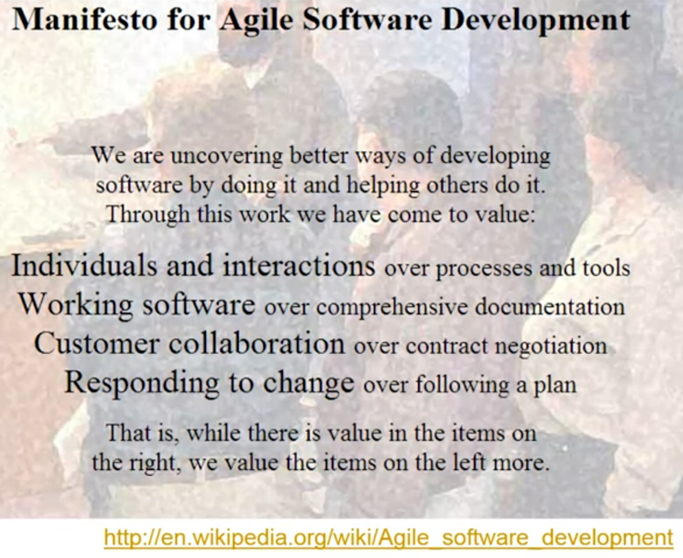

Slide 6
Agile Principles
Highest priority is to satisfy the customer through early and continuous delivery of valuable software
Welcome changing requirements, even late in the development. Agile processes harness change for the customer’s competitive advantage.
Deliver working software frequently, preferably a shorter time scale.

Slide 7
Agile Principles
Businesspeople and developers must work together daily throughout the project.
Build projects around motivated individuals. Give them the environment and support they need and trust them to get the job done.
The best way of conveying information to and within a development team is face-to-face

Slide 8
Agile Principles
Working software is the primary measure of progress
Agile processes promote sustainable development. The sponsors, developers, and users should be able to maintain a constant pace indefinitely.
Continuous attention to technical excellence and good design enhances agility.

Slide 9
Agile Principles
Simplicity is essential. (the art of maximizing the amount of work not done)
The best architectures, requirements, and designs emerge from self-organizing teams.
At regular intervals, the team reflects on how to become more effective then tunes and adjusts its behavior accordingly.

Slide 10
Agile Values and Principles
Memorize them

Slide 11
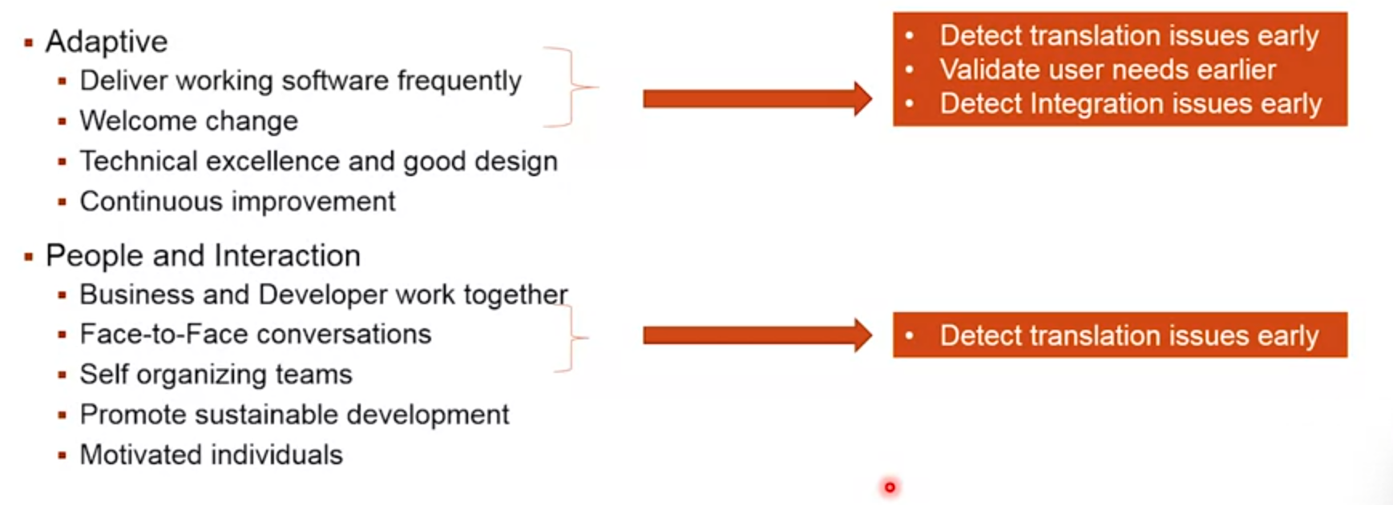
How does Agile solve the challenges of waterfall?

Slide 12
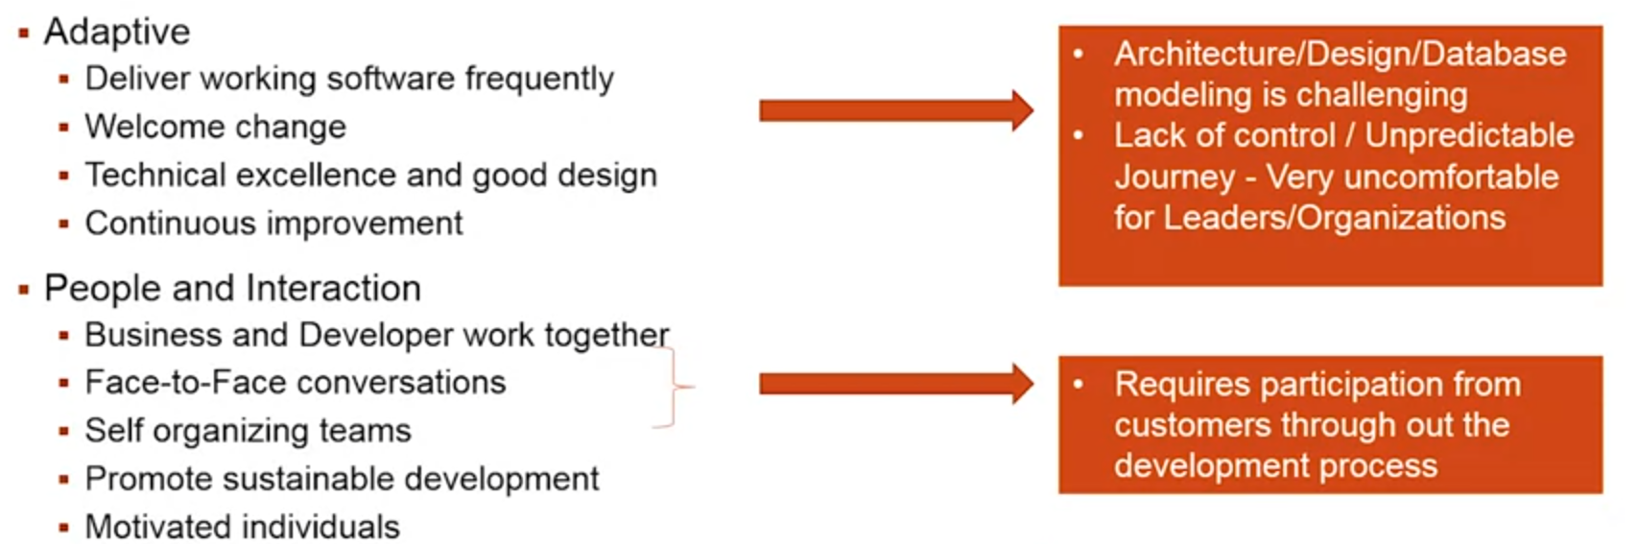
What new challenges does Agile bring?

Slide 13
Scrum
Incremental and iterative framework for developing, delivering, and sustaining products
Assume that customers will change what is wanted
Team
Product owner
Developers
Scrum master

Slide 14
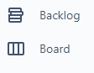
Scrum
Ceremonies
Sprint
Sprint planning
Daily scrum
Sprint review
Sprint retrospective
Backlog refinement
Artifacts
Product Backlog
Sprint Backlog
Increment

Slide 15
Scrum
Some alternative implementations are
Kanban
Scrumban
Kanplan

Slide 16
More Software Development Models
Spiral
Rational Unified Process
Extreme Programming

Slide 17
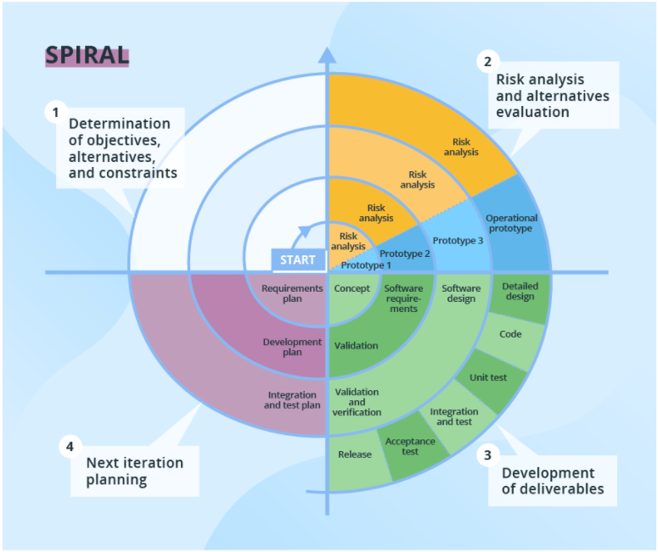
Spiral
Iterative development with systematic controlled aspects of waterfall
High emphasis on risk analysis
Potentially allows incremental releases (or updates) each spiral

Slide 18
Spiral
Changing requirements can be adapted in
Requirements can be captured more accurately
Huge emphasis on risk management

Slide 19
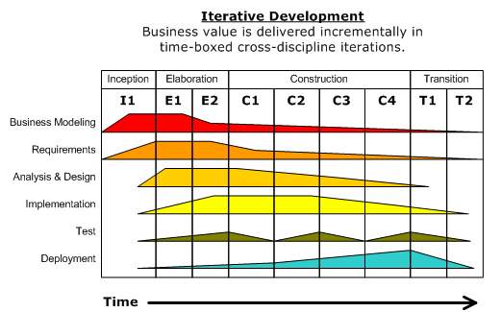
Rational Unified Process – by IBM
Four life cycle phases
Inception
Elaboration
Construction
Transition

Slide 20
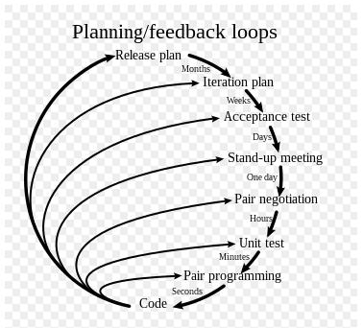
Extreme Programming
Type of agile software development
Working in pairs
Unit testing of all code and acceptance testing of all requirements

Slide 21
Extreme Programming
Don’t program something until it’s needed

Slide 22
Extreme Programming
Four activities:
Coding
Testing
Listening
Designing
29 rules total
Unit tests first (TDD)
Customer is always available

Slide 23
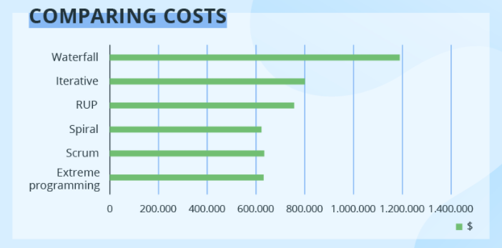
Comparing Costs

Slide 24
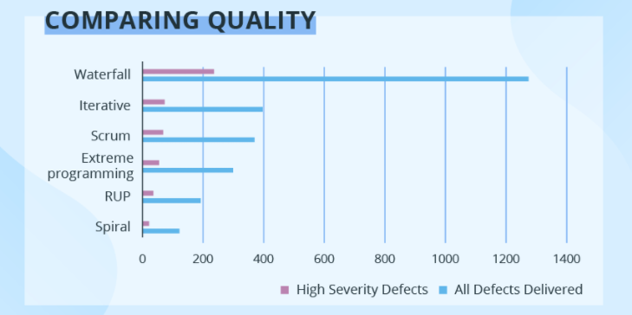
Comparing Quality

Slide 25
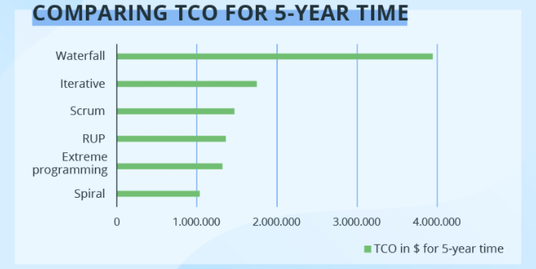
Comparing Total Cost of Ownership over 5 years

Slide 26
Honorable Mentions - these are not answers on quiz 4
Feature-Driven Development
Focuses on designing and building features
Suitable for larger teams
Lean Software Development
Emphasizes waste elimination and value delivery
Derived from Lean manufacturing principles
Kanban
Visual workflow management
Focuses on continuous delivery without overburdening the team

Slide 27
Honorable Mentions - these are not answers on quiz 4
Vibe Coding
An AI-assisted development approach where developers user natural language prompts to generate code, relying on AI models like LLMs.
Characteristics
Rapid prototyping through AI-generated code
Emphasizes speed and experimentation
Developers act more as directors than coders
Strengths
Accelerates development, especially for prototypes
Lowers the barrier to entry for non-programmers

Slide 28
Honorable Mentions - these are not answers on quiz 4
Vibe Coding
An AI-assisted development approach where developers user natural language prompts to generate code, relying on AI models like LLMs.
Weaknesses
Potential issues with code quality and maintainability
Security and scalability concerns
Industry Impact
Startups leveraging vibe coding can operate with smaller teams
Educational courses emerging to teach effective AI prompting techniques

Slide 29
